Slide 1


MINISTRY OF HIGHER EDUCATION AND
SCIENTIFIC RESEARCH
UNIVERSITY OF TUNIS EL MANAR FACULTY
OF SCIENCES OF TUNIS
The integration of the collected
high-voltage data into Geographic Information System (GIS)
Presented by: Essayeh Omar
Professional Supervisor :Mr Ghaleb ENNINE
Academic Supervisor: Mr.Tarek SBOUI
Academic Year :2022-2023
Notes:
mister the president, and the gentleman of the jury.
I start by thanking you all for your attention and for attending my Project discussion.
My project is (read the presentation)

Slide 2
Summary
1
4
Introduction
Integration into the geo-spatial data base
2
5
7
Problem and Objectives
Work flow with Qgis/PostgreSQL
Conclusion
3
6
Data Dictionary , LDM and CDM
Verification of the data
Notes:
Here is the summary of my presentation

Slide 3
01 Introduction

Slide 4



Data Integration
Data integration is the process of bringing data from multiple sources into a single,
location, usually a database.
Data integration is a big deal because it allows us to manage the data
and use it for analytical cases.
Notes:
starting by the introduction (read the paragraph) what we understand from this figure is that we have data in CSV format that we need to integrate into GIS

Slide 5
02 Problematic and objectives

Slide 6
Problematic
Create a relational geo-database . Integrate the data into the created data base .
Digitize the data in QGIS.
STEG Digital mapping is limited and not proficient .
the Data is from various sources and in need for management .
Objectives
Notes:
So the problem is that the ( read from the presentation) Our objective is to solve that problem

Slide 7
03 Data Dictionary, CDM and LDM

Slide 8
Data Dictionary
Tables
Cardinality
Symbology
Contains the features , data types
The relations between the tables
The distinctive
Symbol and colour for each shapefile
Notes:
The data dictionary consist of

Slide 9
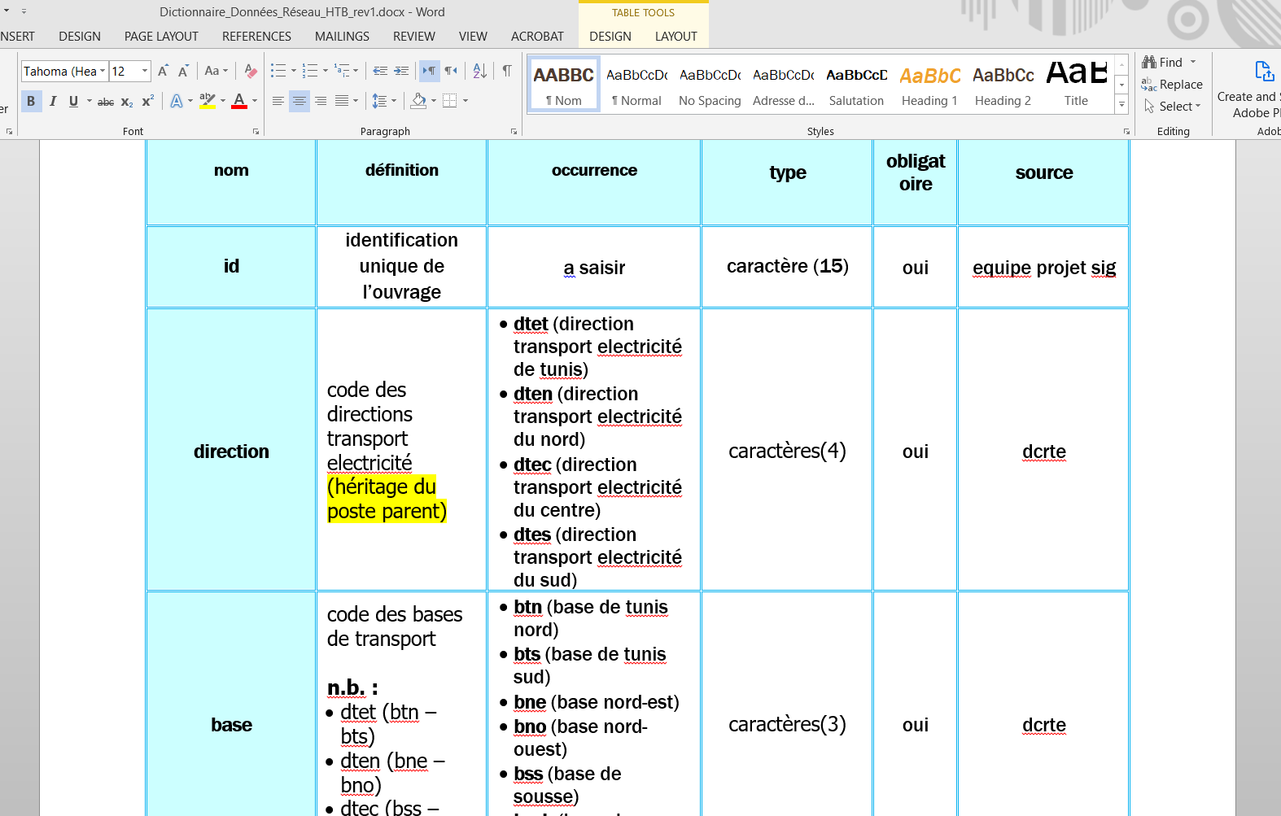

Slide 10
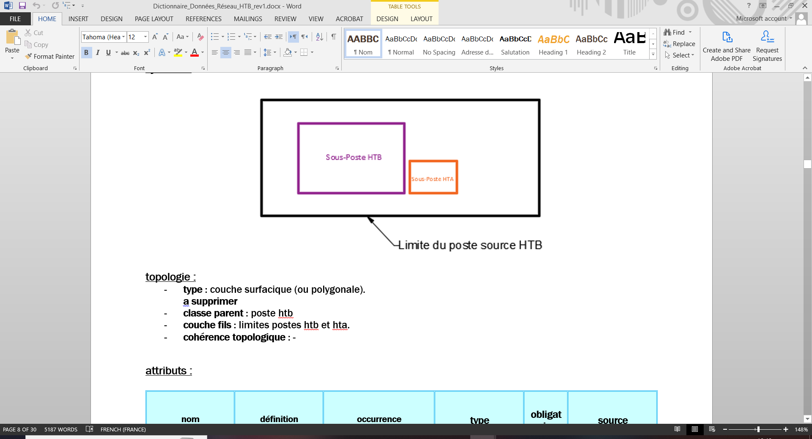
Notes:
Cardinality (in the example here we see that post htb is the parent class and that htb and hta are within that class)
We also can see the symbolgy of these classes

Slide 11
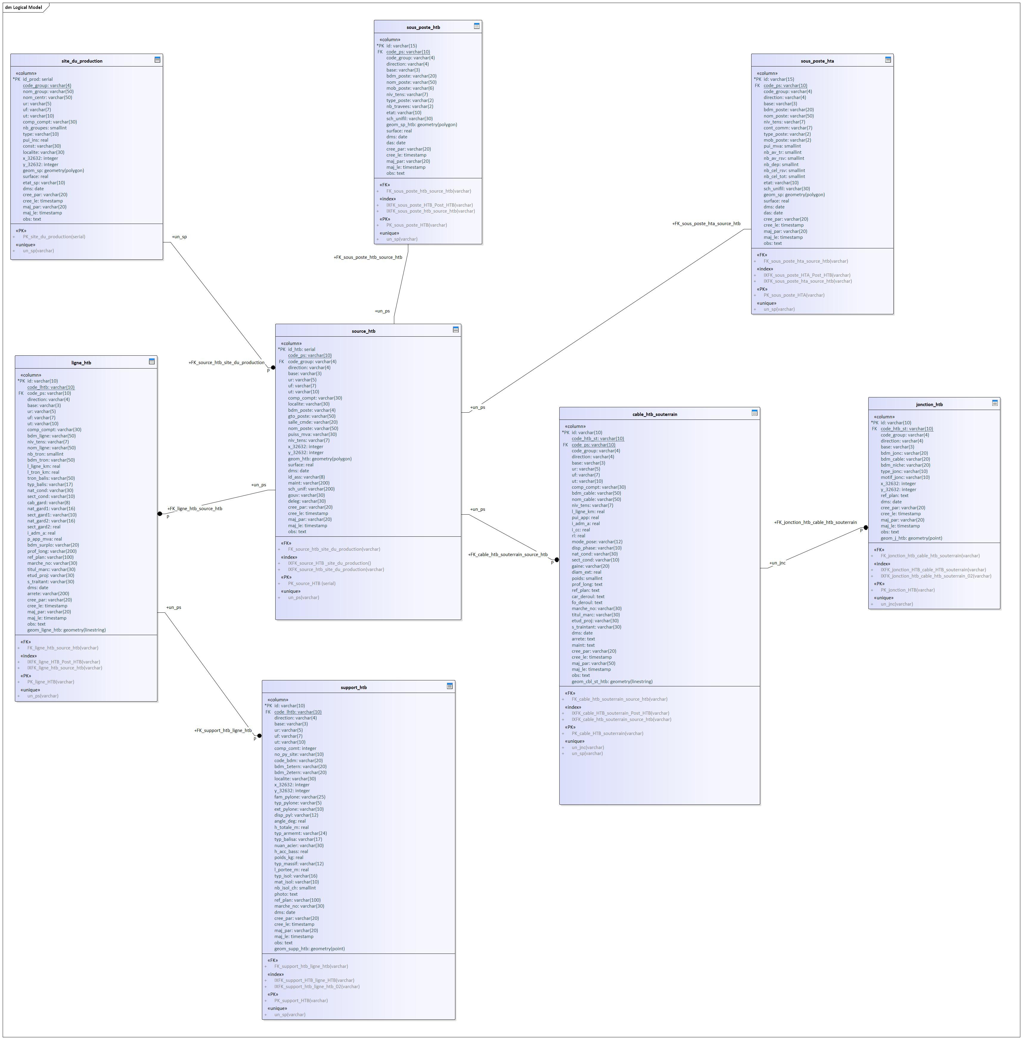
Notes:
Here we have a CDM /LDM diagram representation of the structure of the database

Slide 12
PK
Notes:
Table: If I press and zoom here we can see one of the tables where we can identify the PK the FK that relate this table to another table and the unique constraint which is underlined
There is also the type of each feature we see here the varchar (explain) the integer (explain) geometry polygon which is very important for postgis to recognise this tables as a shape file later

Slide 13
cardinality
Notes:
we can see here the relation between the site du production and the source htb (press the button)

Slide 14
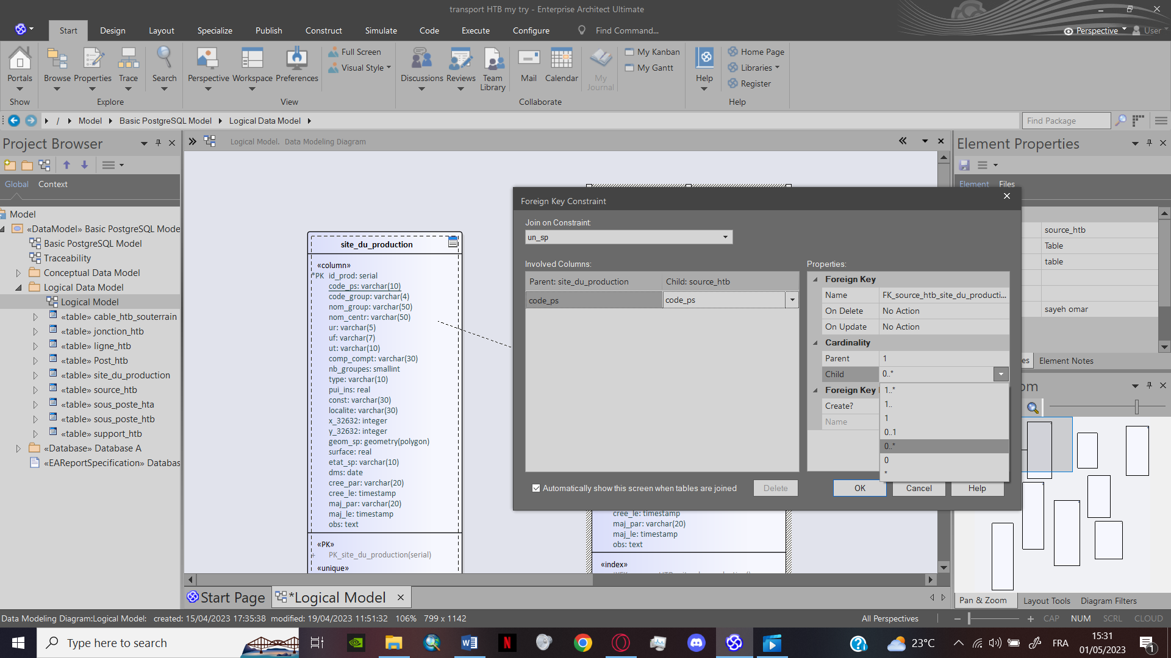
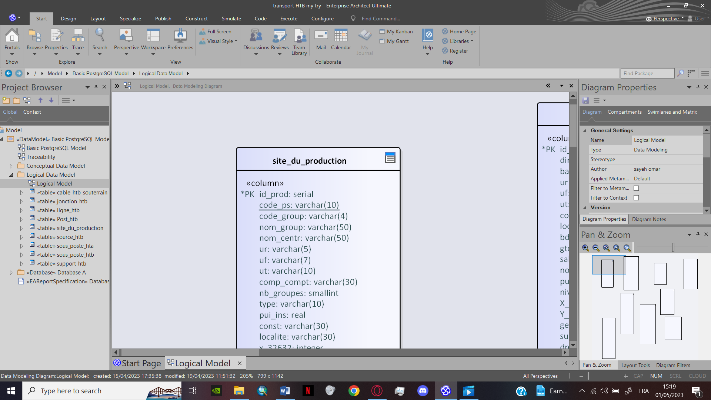
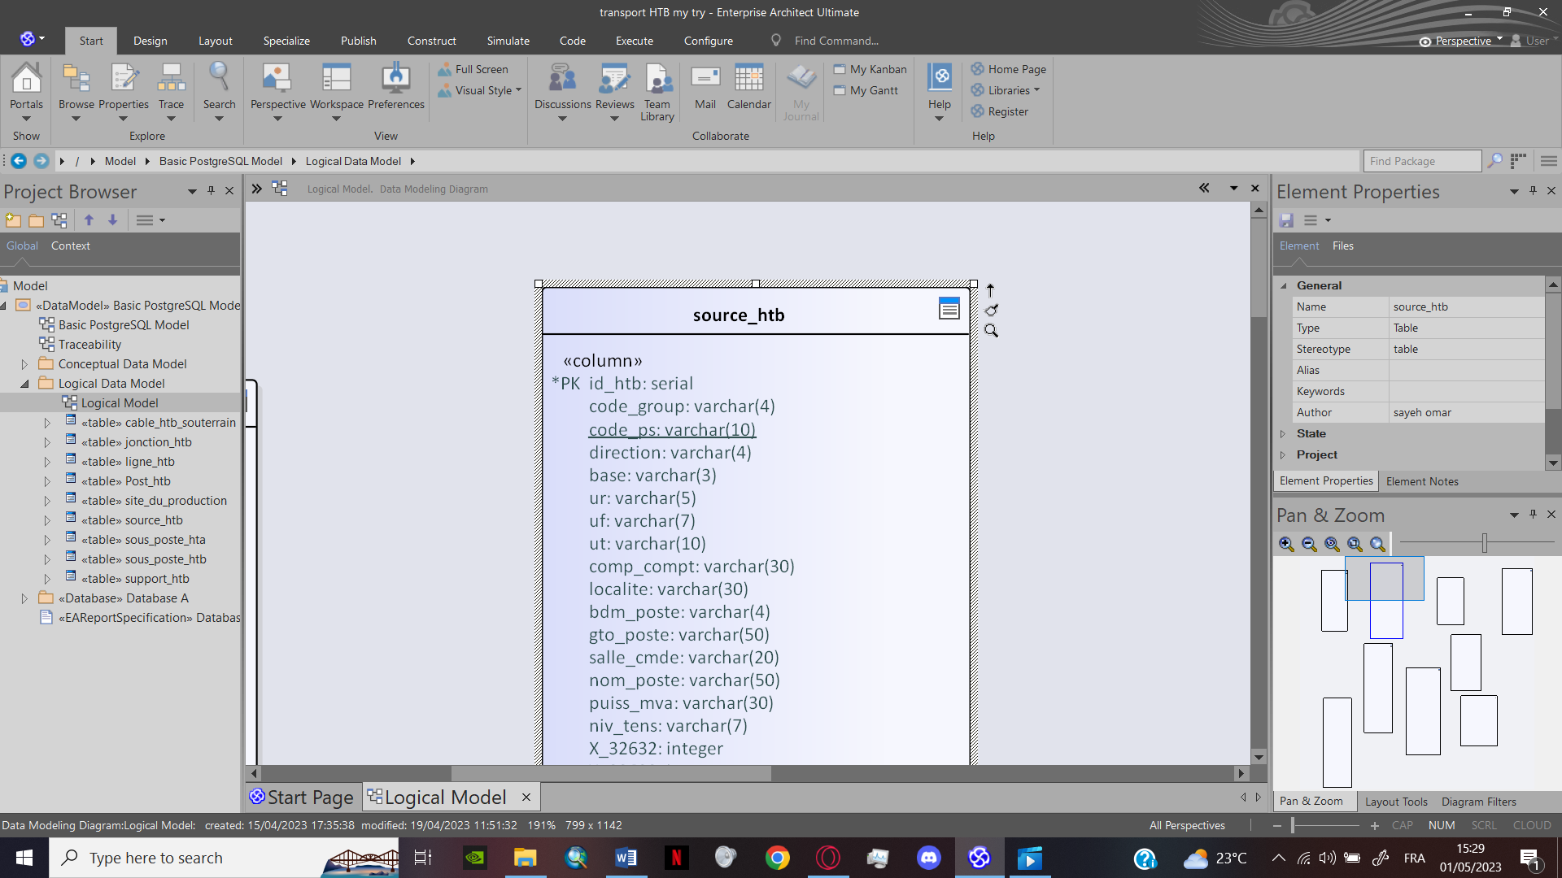
One to Many (1..*)
Notes:
the relation we have here is a 1 to many which means the source htb gets electricity from only one production site but the production site can provide a many source htb with electricity this relation will be a constraint under the name un-sp unique site production

Slide 15
04 Integration into the geo-spatial data base

Slide 16
Data integration
Step 3
Setting up the environment for PostgreSQL
Step 4
Creating the database
Step 5
Step 1
Injecting the SQL Code
Generate the SQL code from Enterprise architect
Step 2
Add the drop down list to the SQL code on VS code

Slide 17
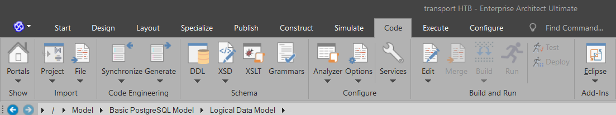
Step 1
Notes:
step 1 (read the presentation) we go to the option bar we select code then DDL / export database schema we save it a single SQL file

Slide 18
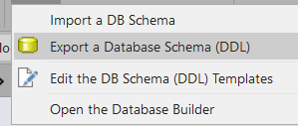
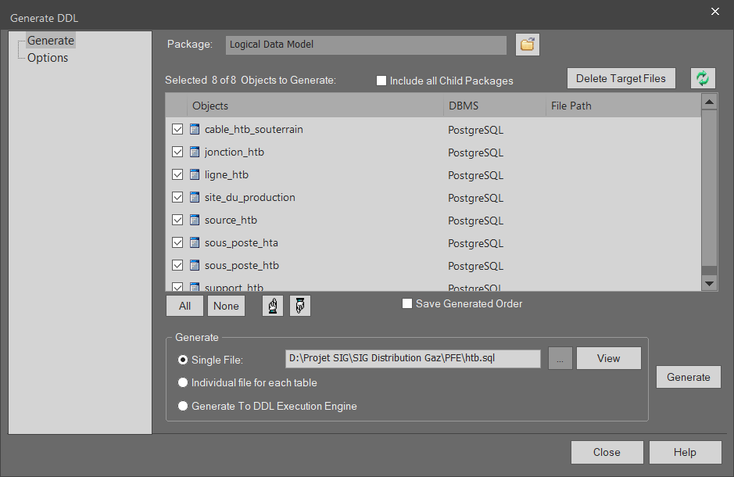
Notes:
step 1 (read the presentation) we go to the option bar we select code then DDL / export database schema we save it a single SQL file

Slide 19
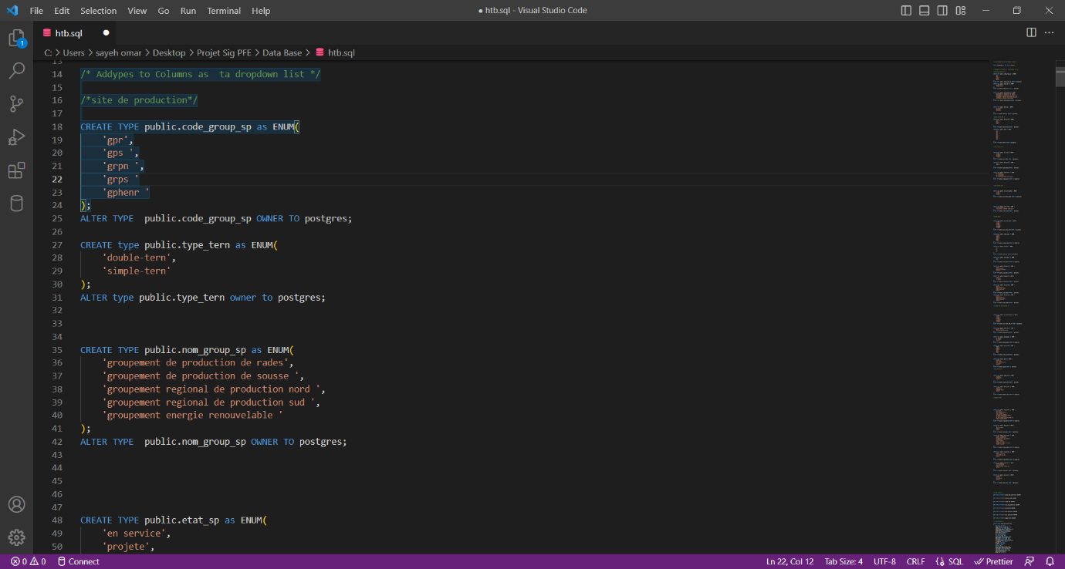
Step 2
CREATE TYPE public.feature_name as ENUM (
Option a,
Option b,
Option c
);
ALTER TABLE public.feature_name OWNER TO Postgres;
Notes:
step 2 (read the presentation) to add a drop downlist we first have to add it the following sql code
Public (name ) makes name a public variable so we can use it in many tables
ENUM is a predefined syntax that allows us to list option in the drop down list
Then we alter the table with variable and mention the owner / user which is postgres in our case

Slide 20
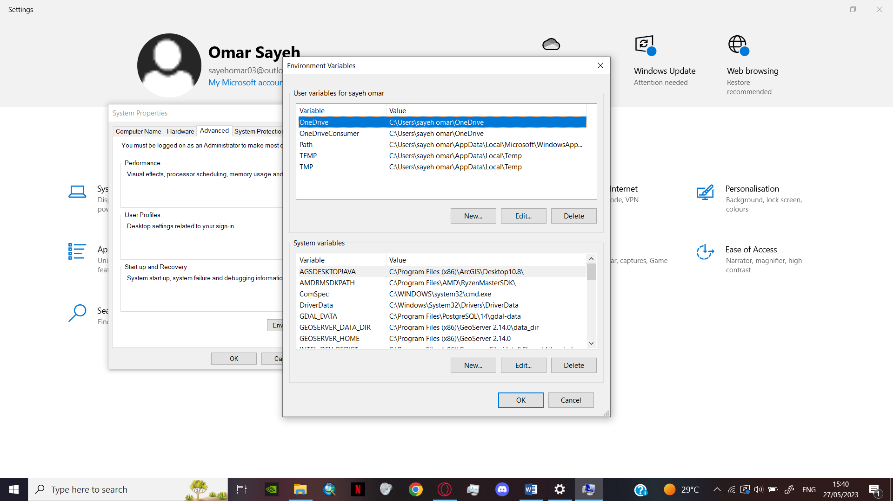
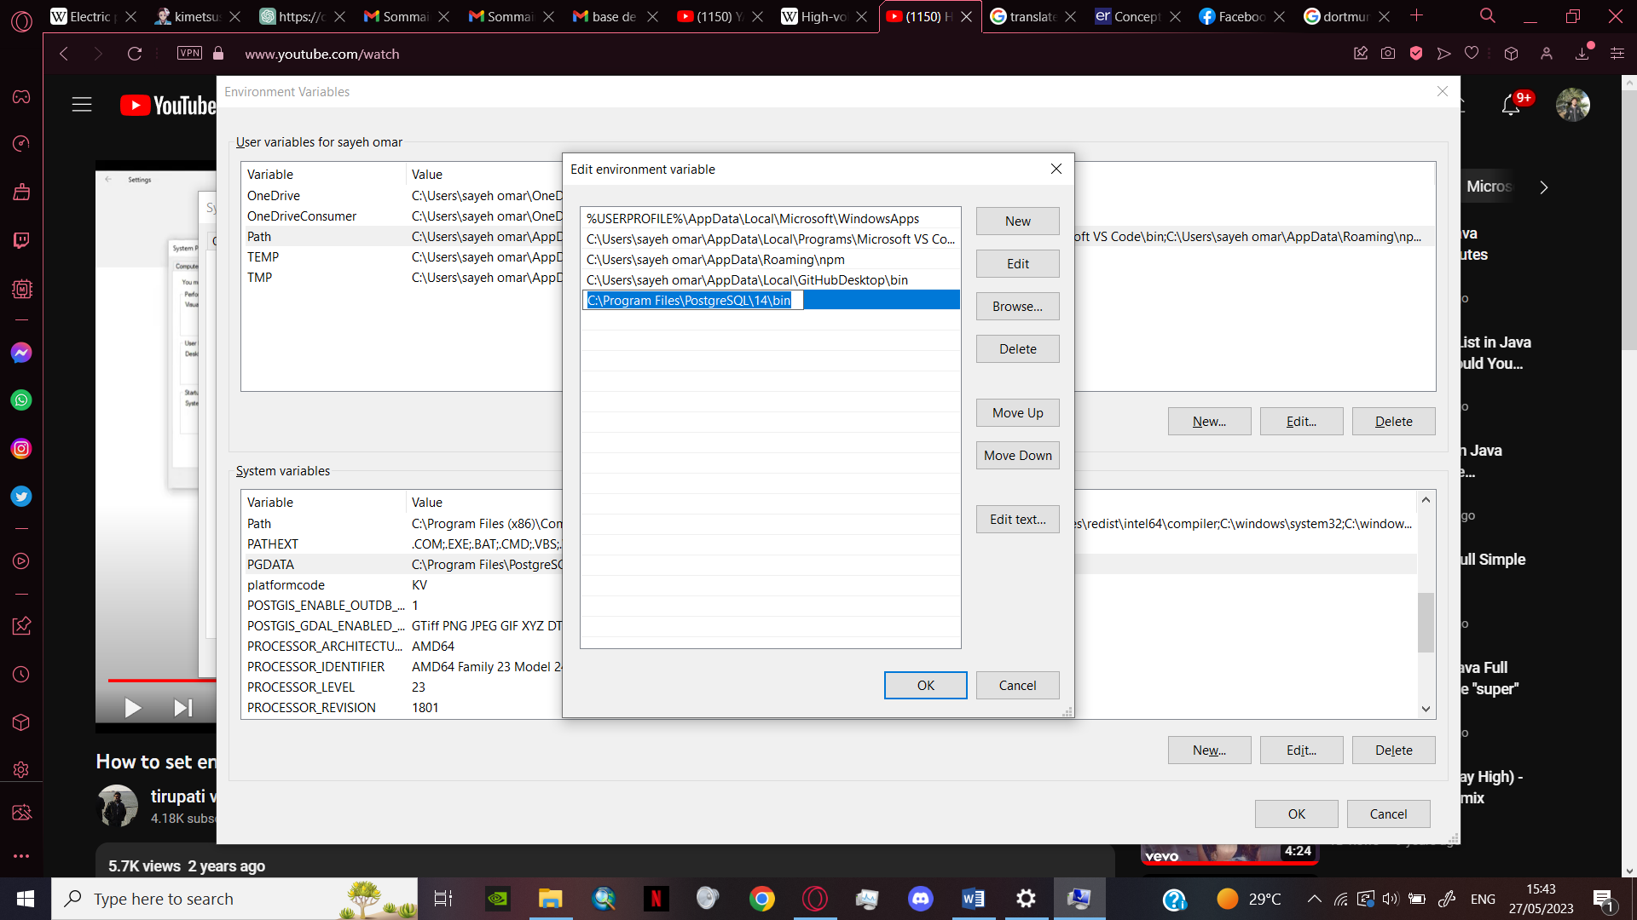
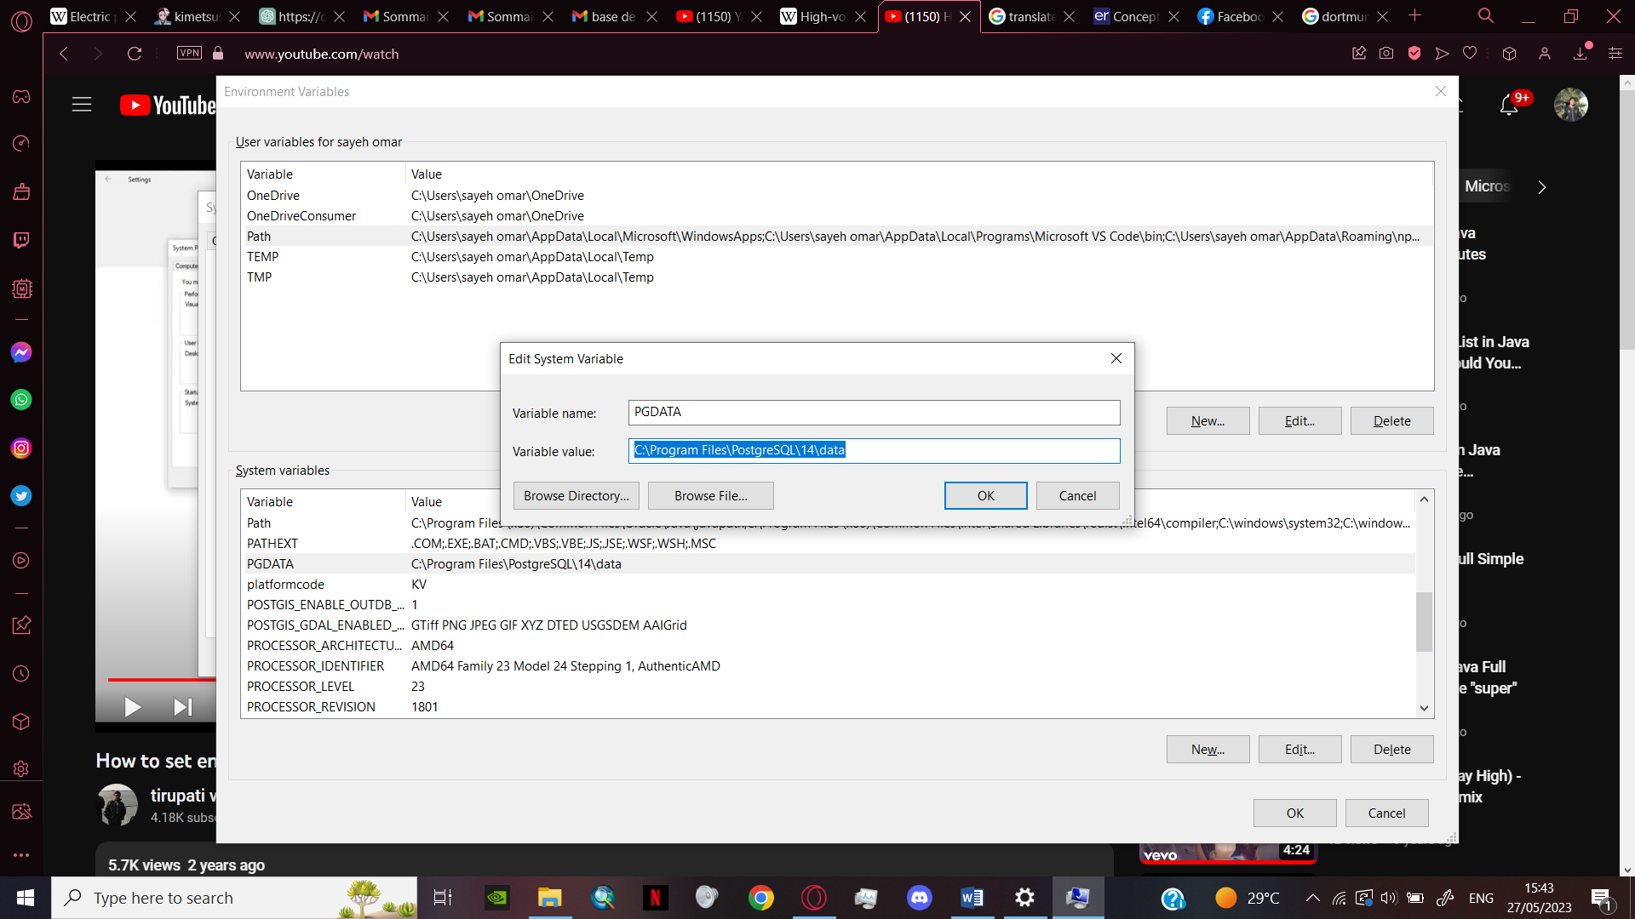
Step 3
Notes:
Step 3 to use the postgresql in the terminal cmd windows has to recogonise it as an environment
We can add the path to the postgres folder in the windows settings (improvise)

Slide 21
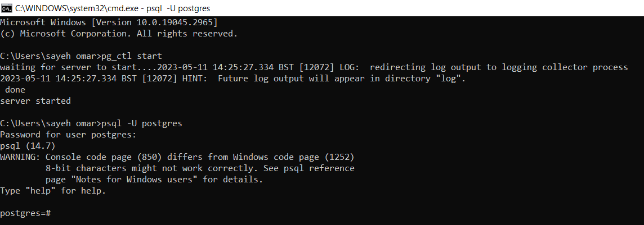
Step 4
Notes:
Step 4 before creating the database first we have to start our server
We type pg_ctl start (explain)
Once the server is working we enter the user and password by typing
Psql –U postgres

Slide 22
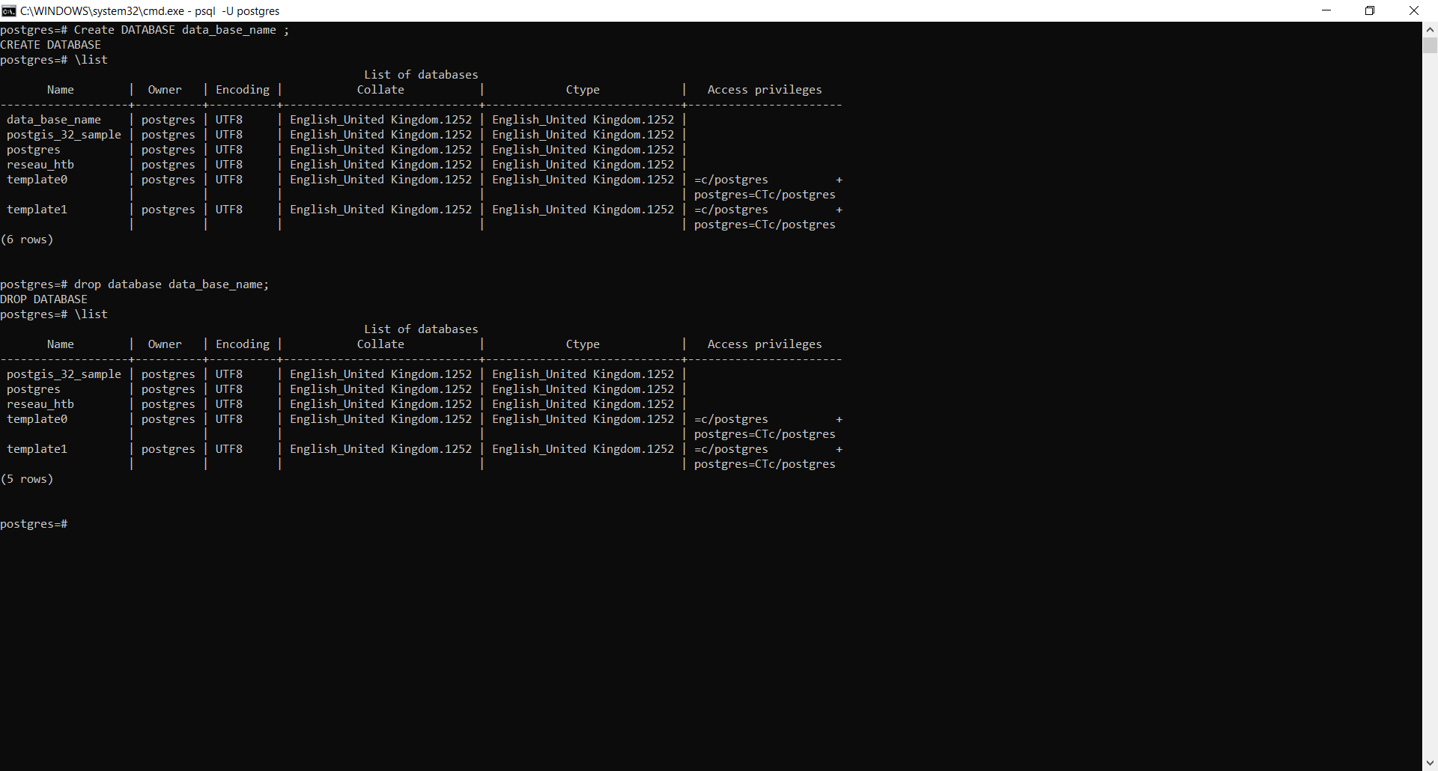
Notes:
after that we create a database by typing
Create database name ;
Then / list; to verify the list of databases we have on our server
To delete a database we type drop database name ; the / list to recheck

Slide 23
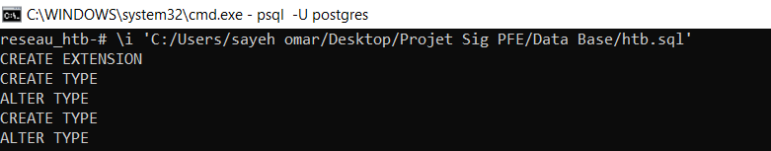
Step 5
Notes:
Step5 we inject the SQL code by typing /i followed by the path of the file

Slide 24
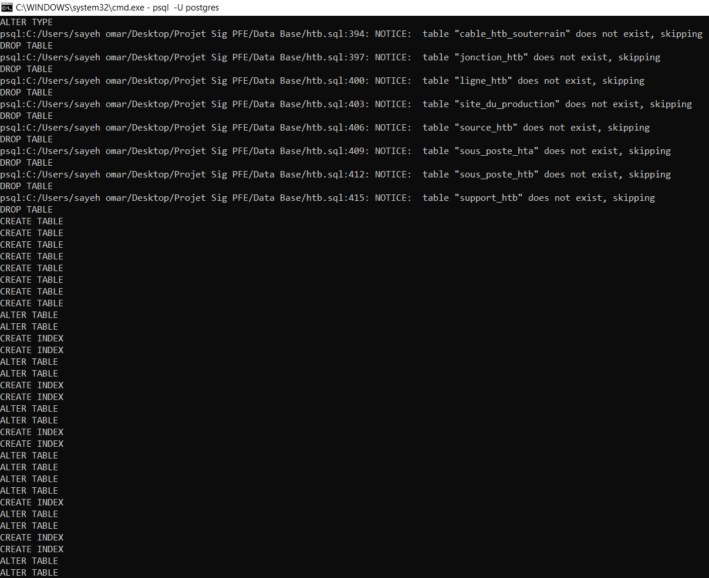

Slide 25
05 Work flow with Qgis/PostgreSQL/ Postgis

Slide 26
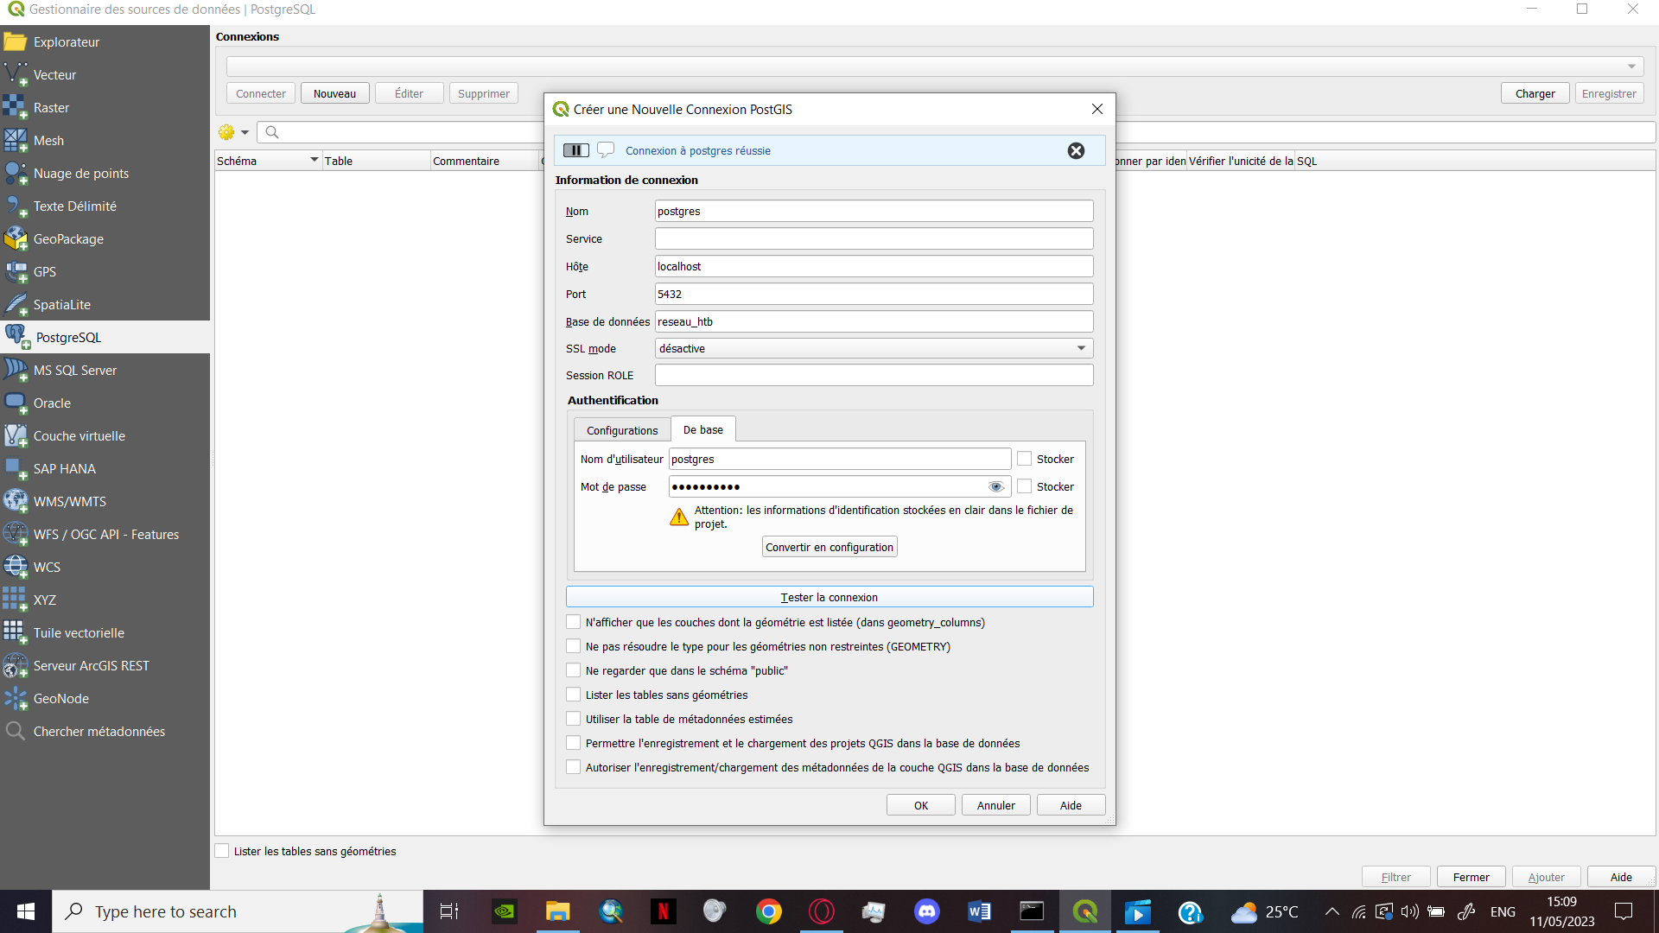
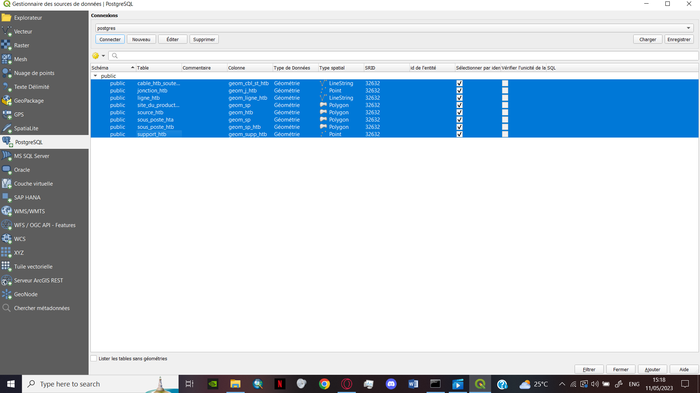
Figuring the username, host ,connection port and the database name
Connecting to the PostgreSQL and selecting the Tables
Notes:
After full creating the database we have to connect it with qgis using the postgres/postgis connection method first we create a new connection followed by adding the username the host the connection port the ofc the database name and we don’t forget the password

Slide 27
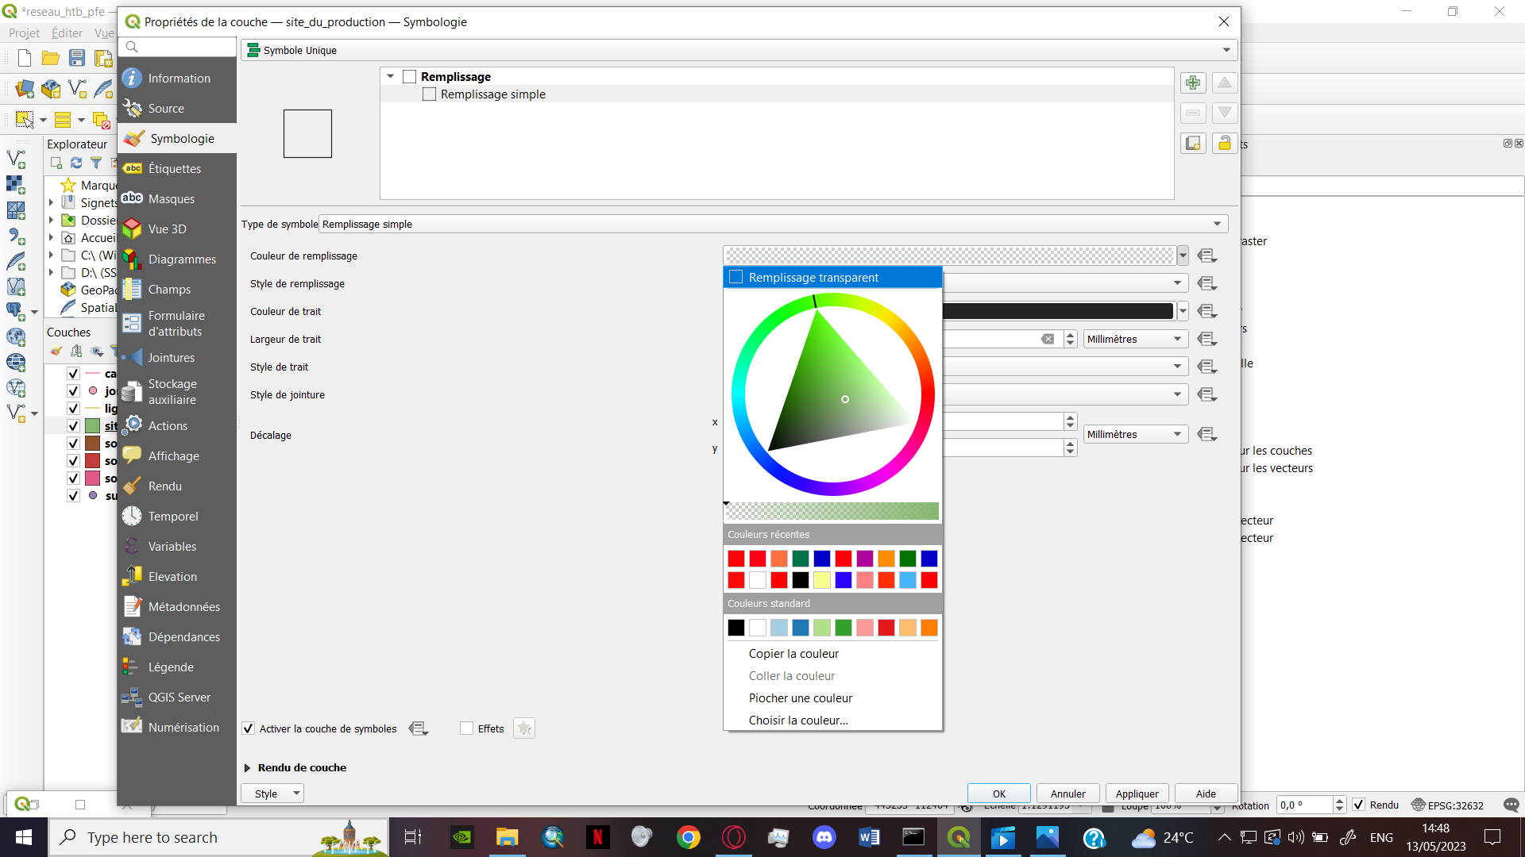
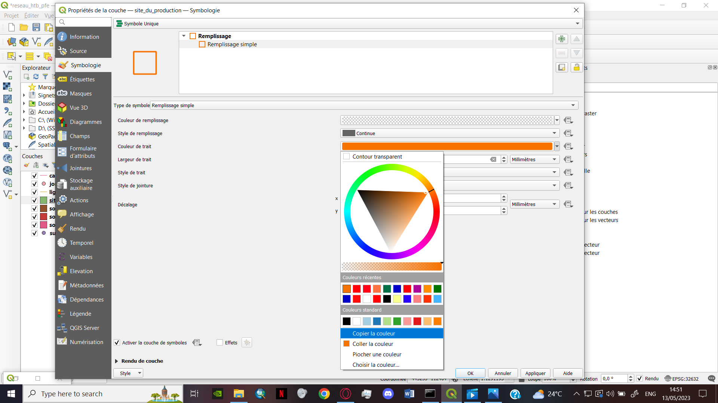
Choosing the colour and the shape according to the dictionary of data
Notes:
Once the connection Is successful we import the tables as shapefile layers next we specify each layer symbolgy wither it is a simple symbol or a SVG symbol

Slide 28
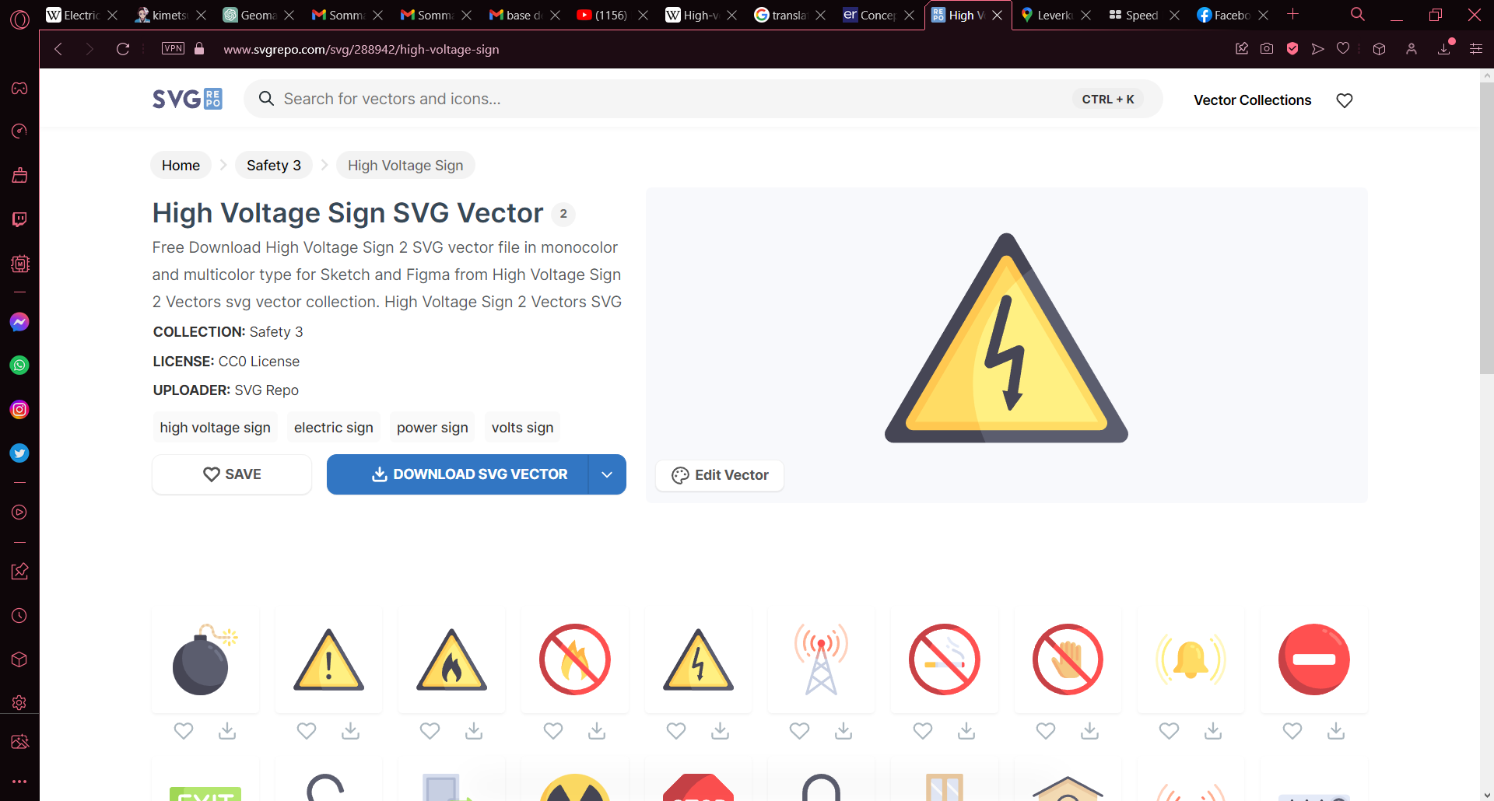
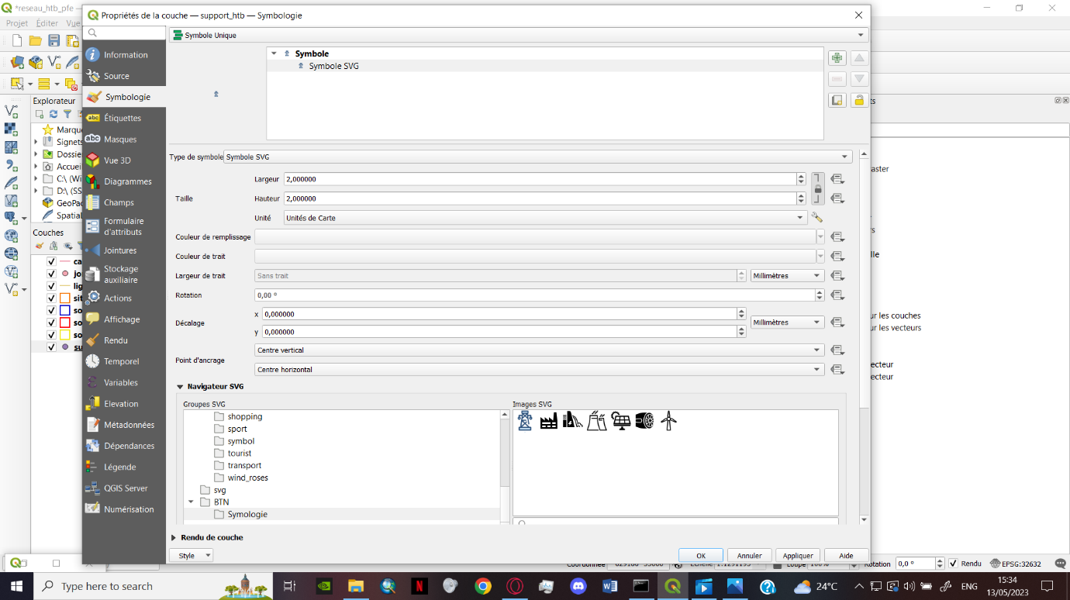
Downloading the SVG from the web
Applying the SVG to the symbology
Notes:
Once the connection Is successful we import the tables as shapefile layers next we specify each layer symbolgy wither it is a simple symbol or a SVG symbol

Slide 29
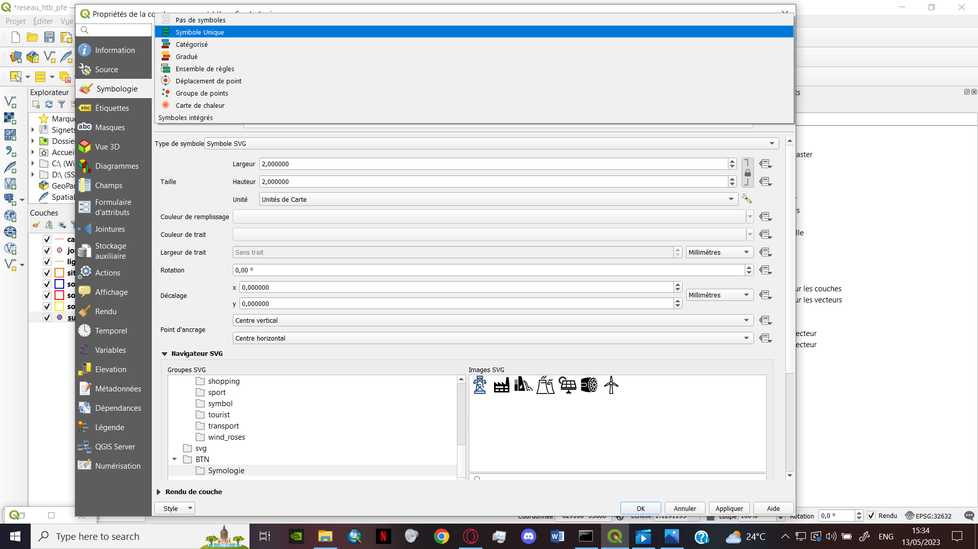
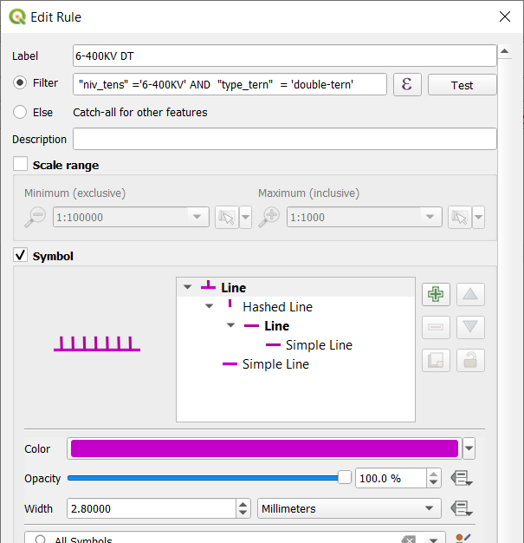
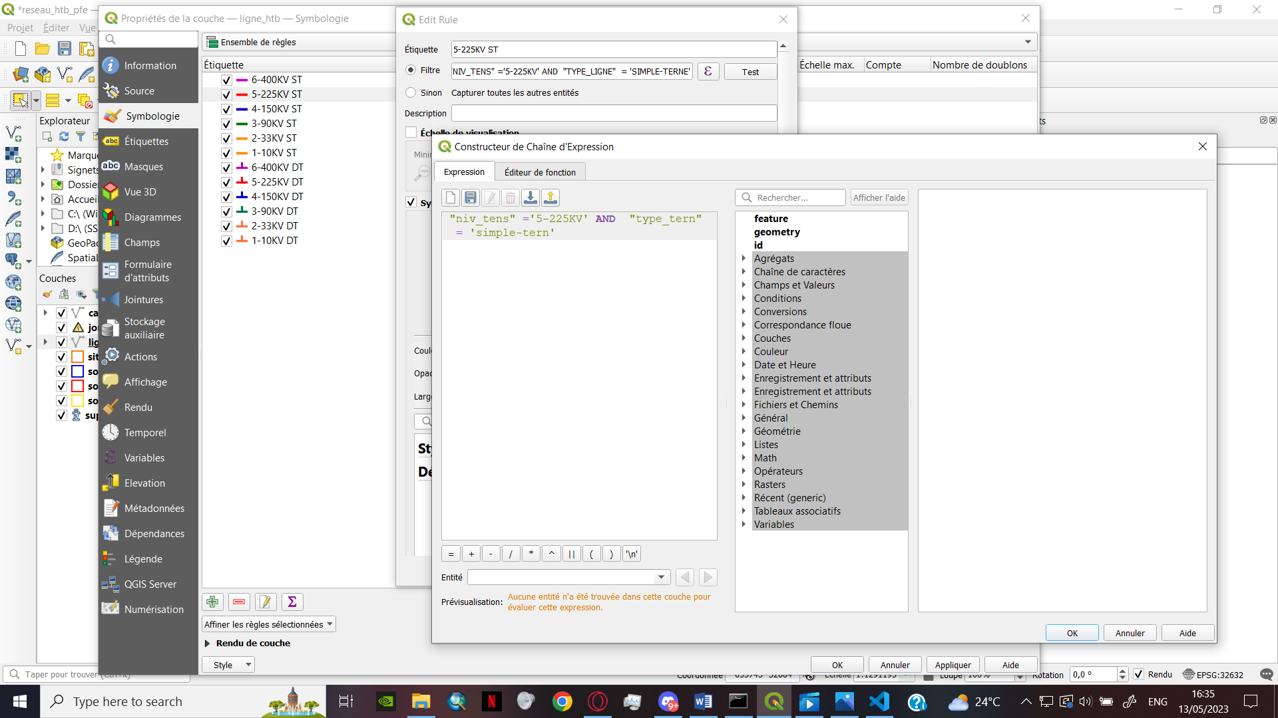
Notes:
some layers represent more than type of information to solve that problem we had to insert a special script that regulate the type of information shown on by the layer

Slide 30
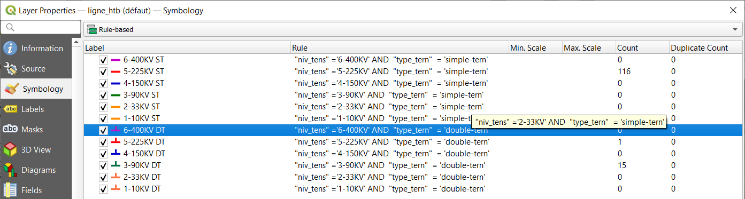
Script that regulate the symbology
Label / Symbol
Notes:
We can see here the labels and the symbol + script

Slide 31
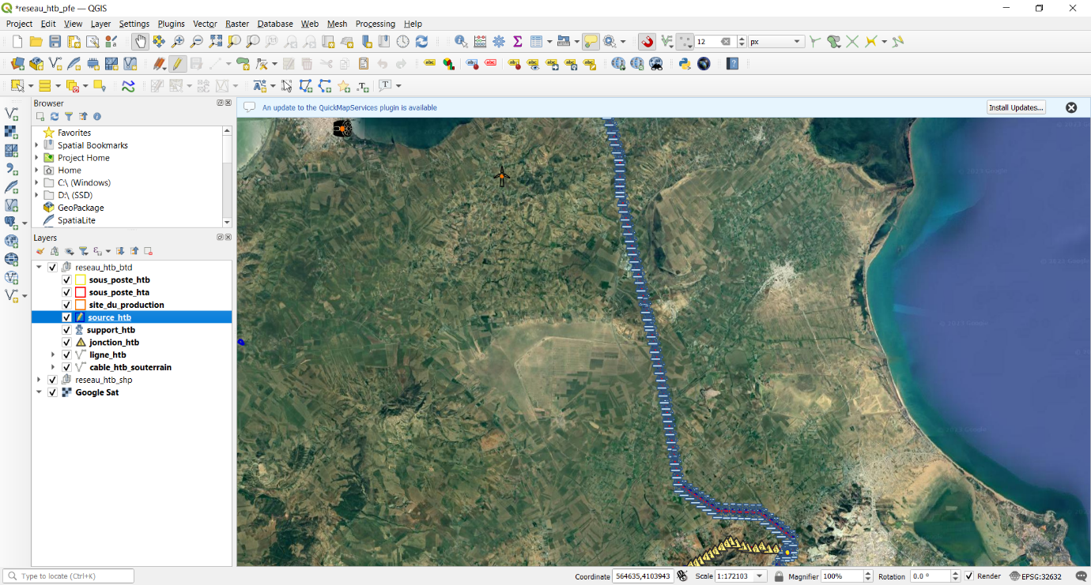
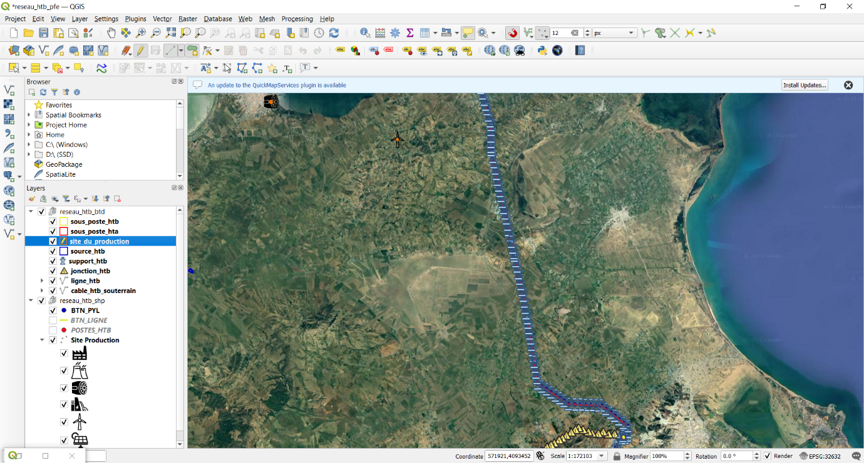
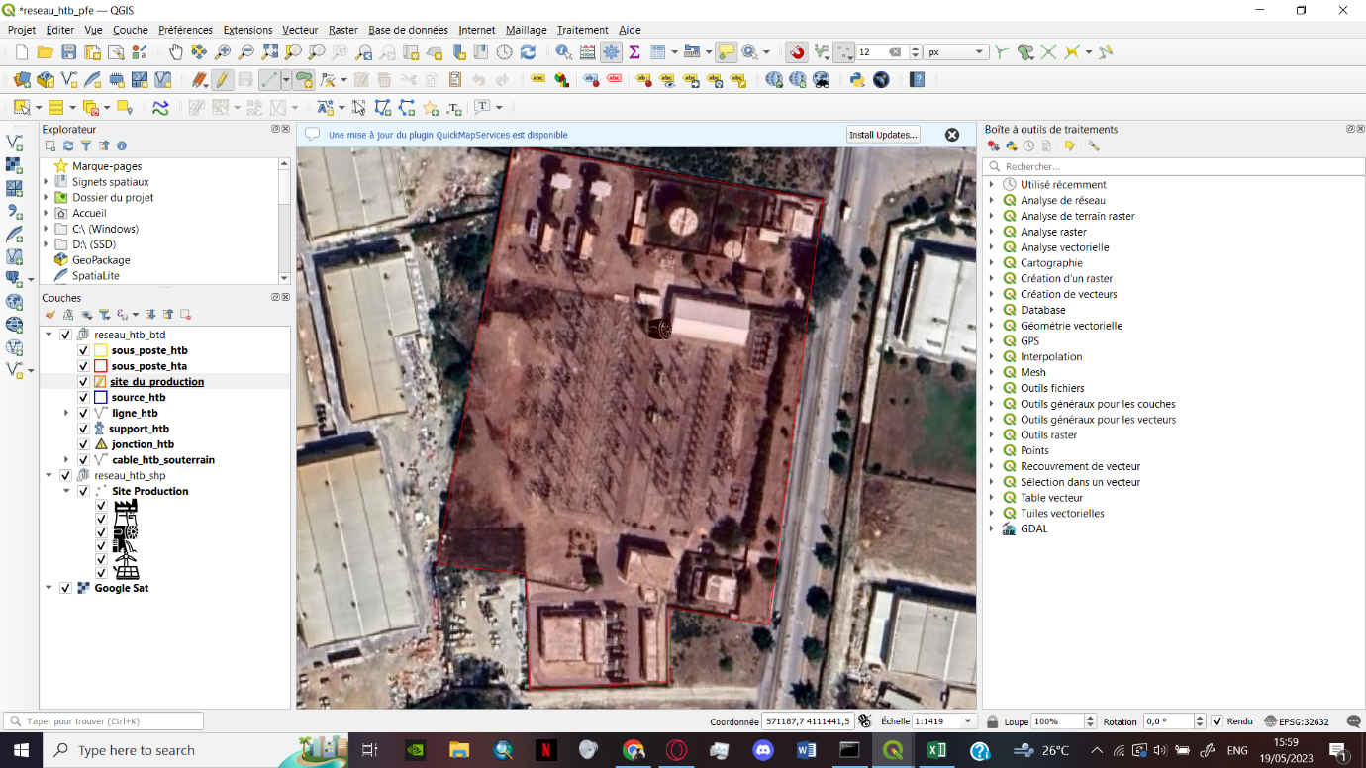
Selecting the layer and drawing the shapefile
Notes:
After finishing the symbology we start to draw and entering the data by toggling the editor pencil and selecting the wanted layer

Slide 32
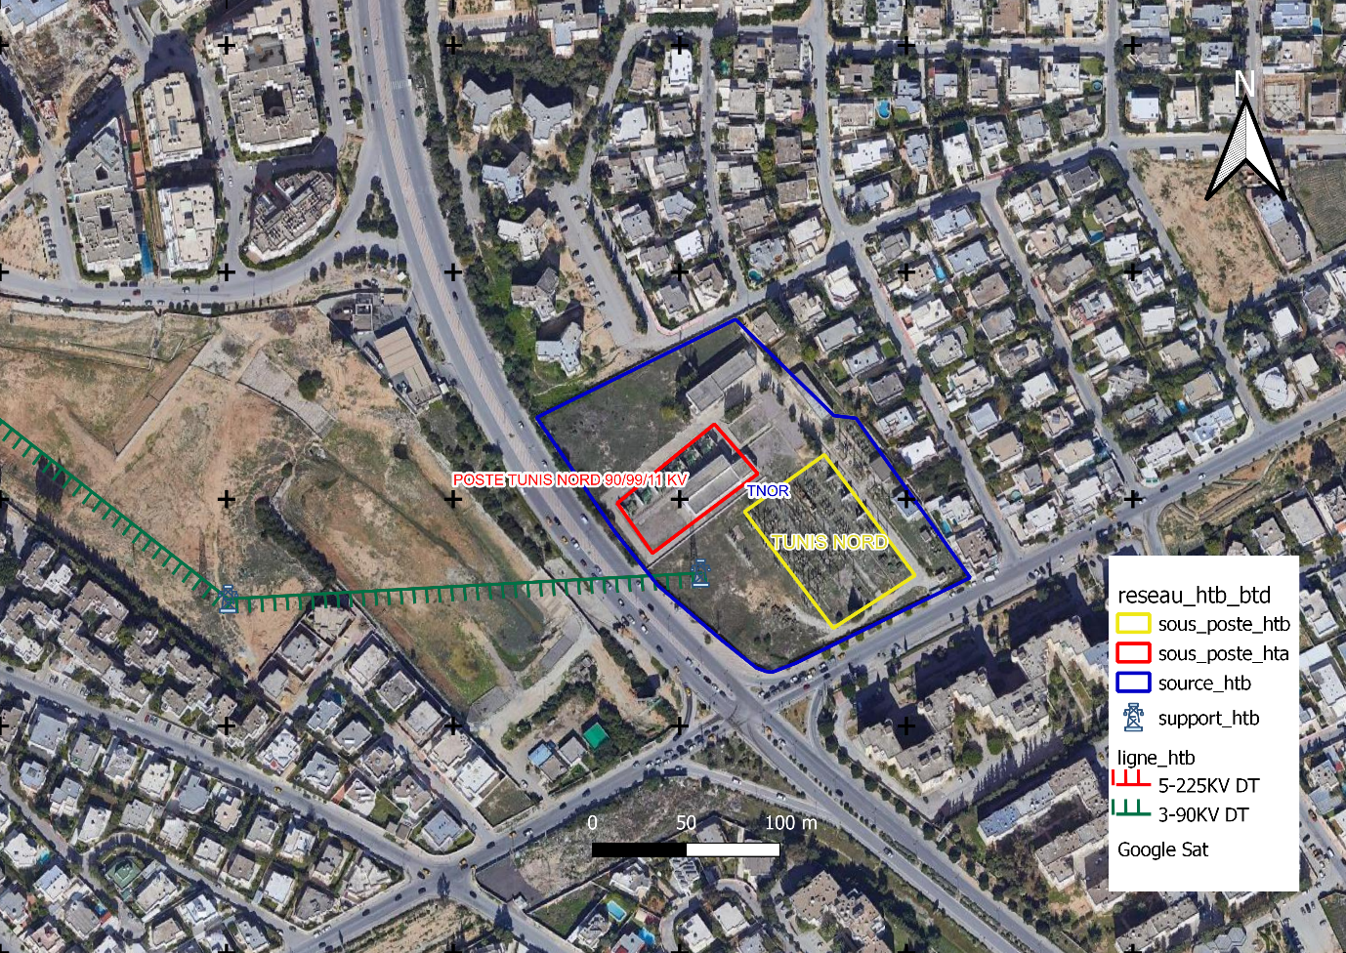
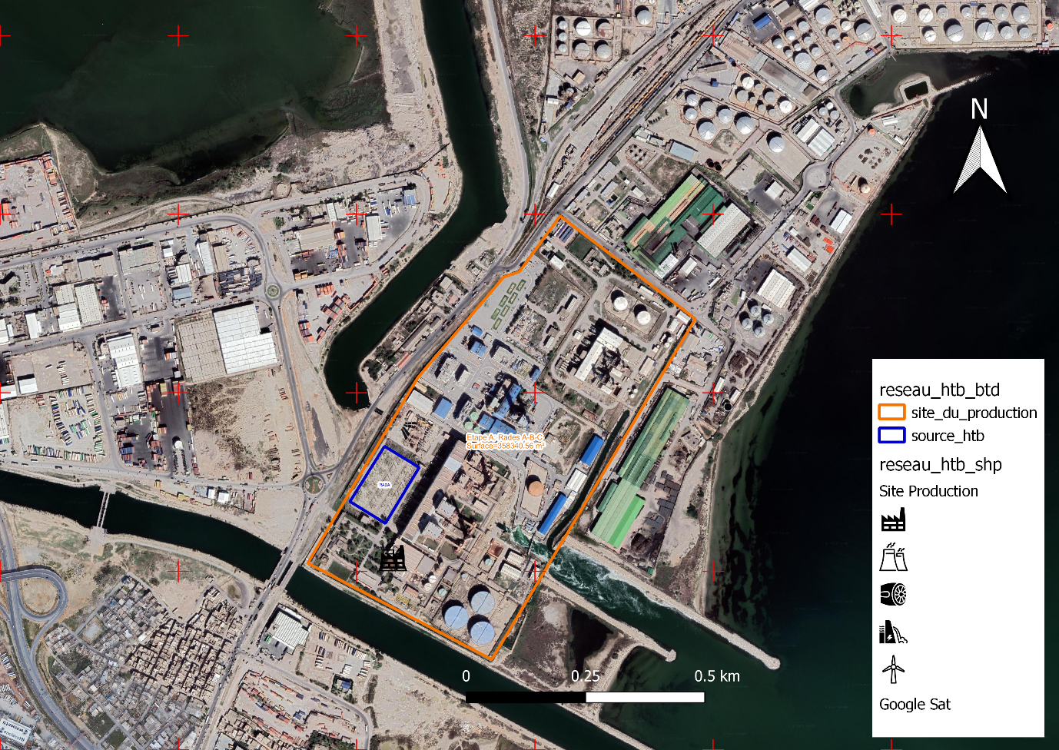
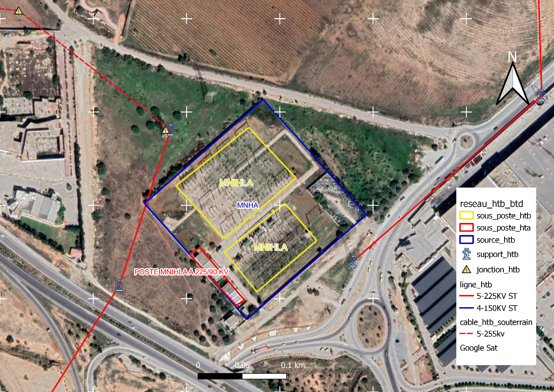
Results

Slide 36
Caution
Notes:
While entering the data we faced a problem with the constraint of one of the tables but thanks to the connection between postgres and qgis we were able to alter the constraint by deleting it

Slide 37
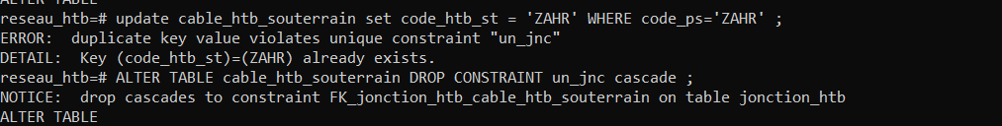
Altering Tables Constraint
ALTER TABLE cable_htb_souterrain DROP CONSTRAINT un_jnc CASCADE ;
Notes:
While entering the data we faced a problem with the constraint of one of the tables but thanks to the connection between postgres and qgis we were able to alter the constraint by deleting it

Slide 38
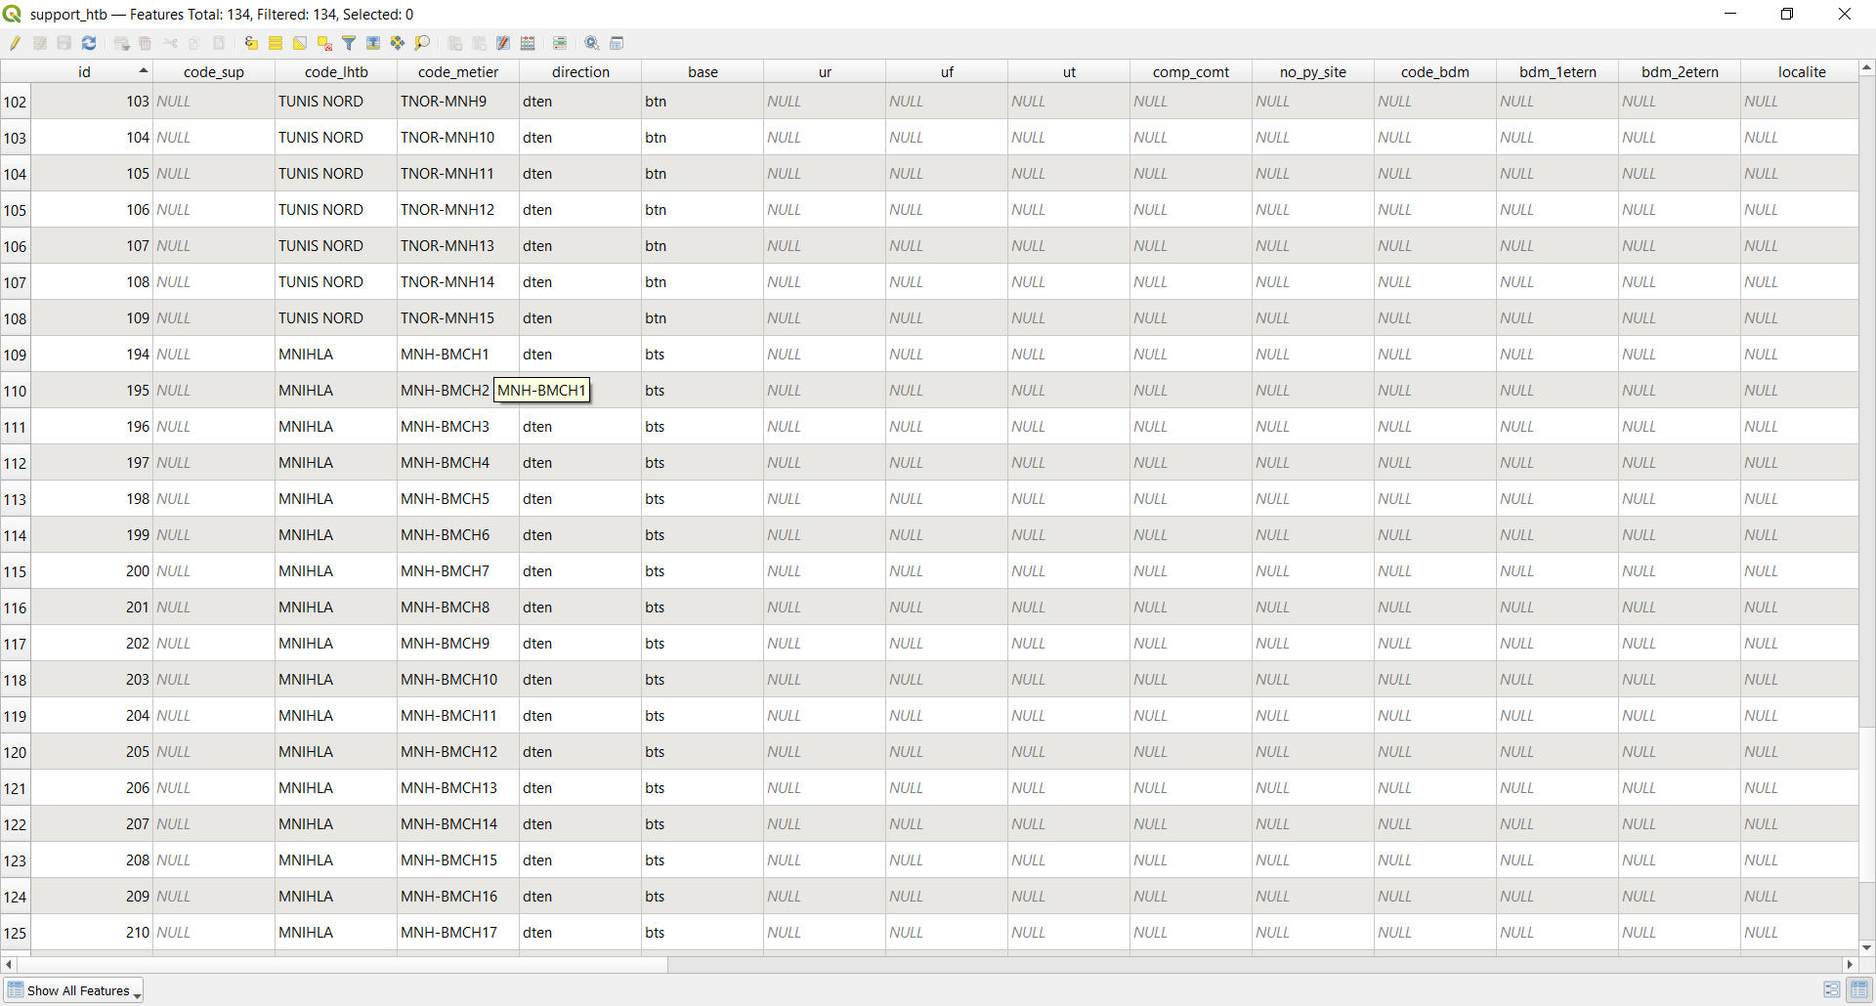
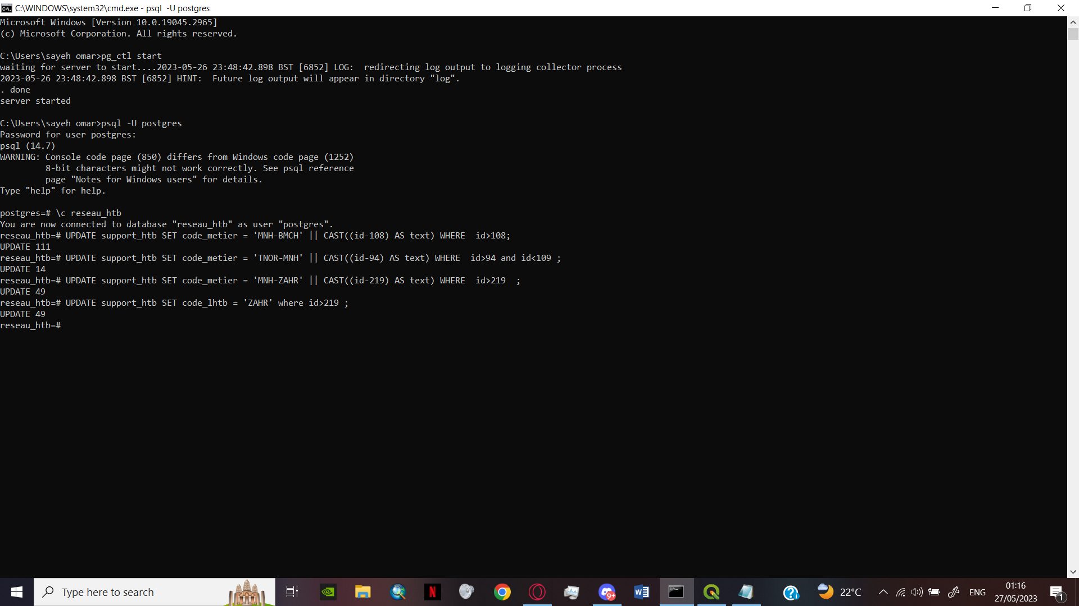
Updating the column with a SQL query
UPDATE support_htb
SET code_metier = 'MNH-BMCH' || CAST(id AS text)
WHERE id>108;
Notes:
We also had to update some data we entered in this case we wanted the code metier value to reset every time it code_lhtb changes (explain the code)

Slide 39
07 Verification of
the data
Notes:
Postgresql allows us to verify and identify specific type of data throughout simple queries

Slide 40
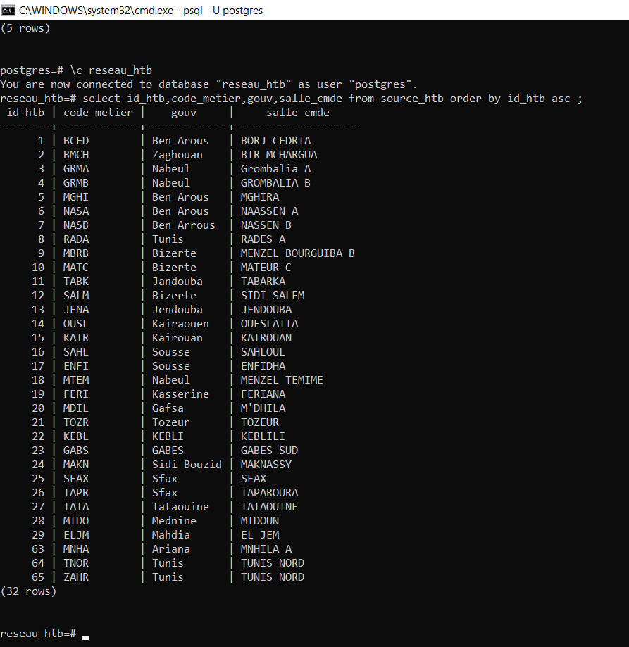
The value from the source_htb column on an ascending order
SELECT id_htb,code_metier,gouv,salle_cmde
FROM source_htb
ORDER BY id_htb asc ;

Slide 41
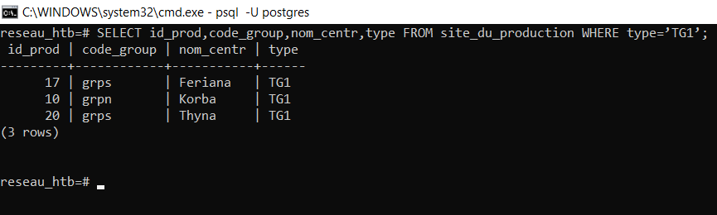
the values in the site_du_production with a condition on the type
SELECT id_prod,code_group,nom_centr,type
FROM site_du_production
WHERE type=’TG1’;

Slide 42
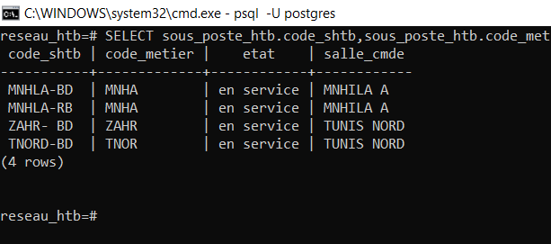
SELECT sous_poste_htb.code_shtb,sous_poste_htb.code_metier, sous_poste_htb.etat, source_htb.salle_cmde
FROM sous_poste_htb
JOIN source_htb
ON sous_poste_htb.code_ps = source_htb.code_ps;
the values of the sous_post_htb joined by source_htb with a condition on the FK code_ps
Notes:
Some times to display a value from two different tables we use a joint with the help of the FK
Here we selected the …. From two tables that are connected

Slide 43
07 Conclusion

Slide 44
Recap
Connection between the GIS and the database management system
Verification of the data with SQL queries
Enhancing the SQL code
Creation of the structure of the data base
PostgreSQL
Qgis-PostgreSQL
Drop down list
CDM,LDM
Qgis
PostgreSQL
SQL code
Integrating the Data and represent it on the map
Generation of the SQL code
Creation of the database , injection of the code , alternation of the constraints
Notes:
In a quick recap we (readpresentation)

Slide 45
STEG
Qgis
Has a collect of data in old fashion methods (paper, excel files ,…)
GIS Software able to interact with relational data bases.
Post-GIS
Postgres
An object-relational database system able to handle a loads of data .
a spatial database extender for PostgreSQL object-relational database. support geographic objects allowing location queries to be run in SQL.
A functionable Geo-Database
Notes:
and in conclusion (explain the graph ) thnx to STEG collected data qgis and postgresql working flow and the postgis capability of handeling geographic objects

Slide 46
Thanks for your attention

